Slide 1
Elastic stream processing with Apache Storm
Background and Capabilities

Slide 2
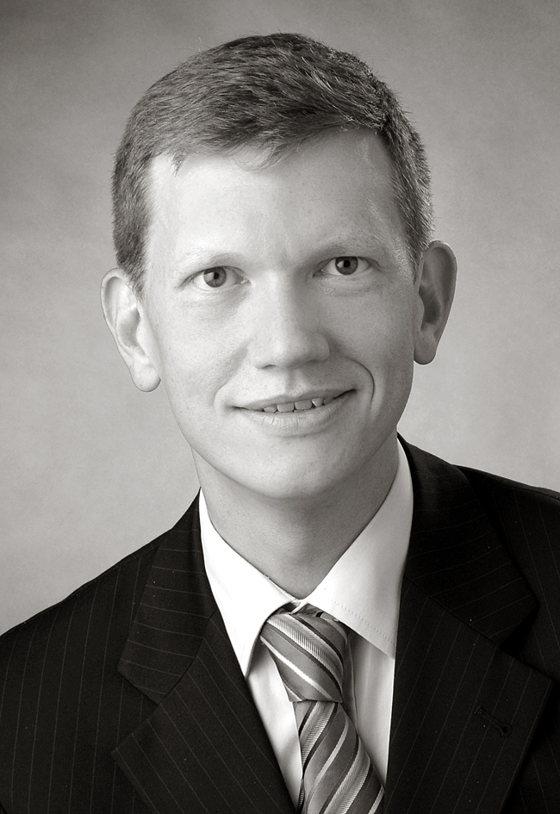
Who I am?
Your Speaker
Some (professional) projects
2005: Enterprise Application Integration for a Capital investment company
2008: Introduction of Enterprise Service Bus at at a German Online Bank
2010: Migration of an Output Management System at a German insurance
2012: Application development and product integration at a German financial services provider
Hobbies
Dancing (Standard, Latin)
Martial Arts
Running / Triathlon
Technology ☺
Vita
2005: entory, Deutsche Börse Group
2008: cirquent, BMW Group
2011: msg systems

Slide 3
Elastic Stream Processing With Apache Storm
Agenda
1
The value-chain of computation
3
2
Overview of computation models
8
Batch processing
8
Online processing
10
Stream processing
12
3
Frameworks for computation
14
Bulk data processing
14
Stream data processing
16
The lambda architecture
18
4
Apache Storm
21
5
Examples
29

Slide 4
Elastic Stream Processing With Apache Storm
Agenda
1
The value-chain of computation
3
2
Overview of computation models
8
Batch processing
8
Online processing
10
Stream processing
12
3
Frameworks for computation
14
Bulk data processing
14
Stream data processing
16
The lambda architecture
18
4
Apache Storm
21
5
Examples
29

Slide 5
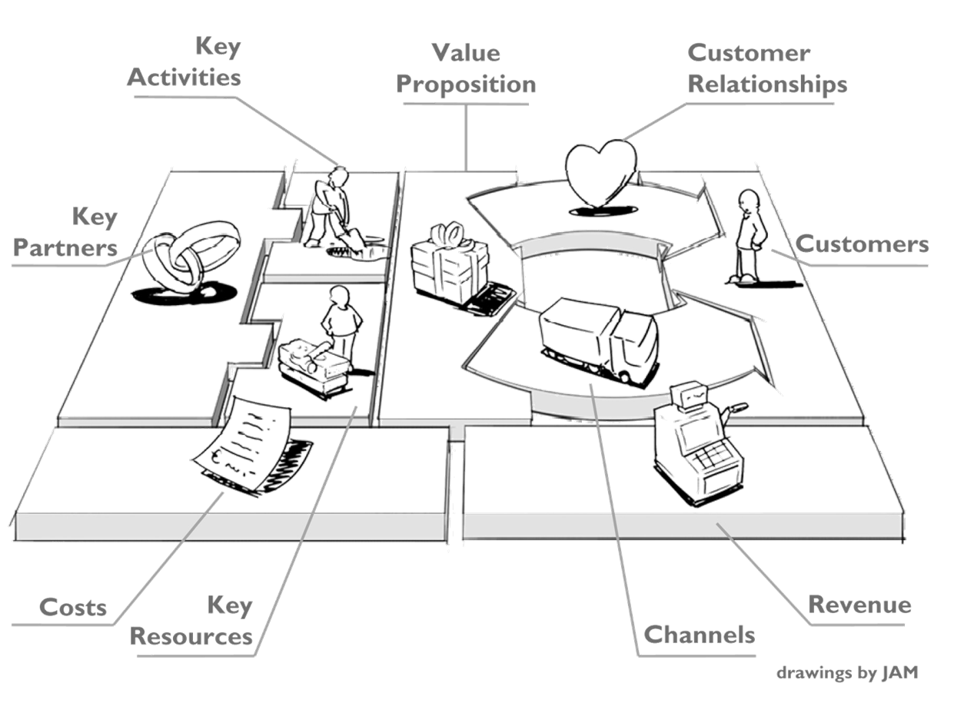
Data is created, processed and transformed throughout a business (model, process, step).
Data and the Business Model Canvas

Slide 6
In information processing, raw data is processed and action is derived from it.
IT is information processing
Aggregation Transformation Manipulation
Information
Normalization Aggregation Transformation
Data
Data is mostly not used in its raw form
Data is stored in a (relational) store and enriched by meta-data (time, date, …)
Data is transformed to Information by normalization, aggregation, etc.
Information is processed.
Information is queried to generate Insight.

Slide 7
Commoditization leads to a stronger business and data focus.
Trends in Computing
Yesterday
Today
Tomorrow
Business is planable and problems are specific.
Small data
Infrastructure is simple
Load Balancer
Computation is expensive (CPUs)
Memory is expensive (DRAM)
Disk storage is expensive (HDD)
Business is dynamic and problems are complex.
Large data
Infrastructure is complex
(virtual) load balancer
Software Defined Network / Data Center
Computation is cheap (Multi-Core Architectures)
Memory is cheap (DRAM)
Disk storage is cheap (SSD)
Business is volatile and problems are context driven.
Big data
Infrastructure is commodity
Cloud platforms
Data processing platforms

Slide 8
Commoditization leads to a stronger business and data focus.
Trends in Computing
Support Business
Automate Business
Drive Business
Business is planable and problems are specific.
Small data
Infrastructure is simple
Load Balancer
Computation is expensive (CPUs)
Memory is expensive (DRAM)
Disk storage is expensive (HDD)
Business is dynamic and problems are complex.
Large data
Infrastructure is complex
(virtual) load balancer
Software Defined Network / Data Center
Computation is cheap (Multi-Core Architectures)
Memory is cheap (DRAM)
Disk storage is cheap (SSD)
Business is volatile and problems are context driven.
Big data
Infrastructure is commodity
Cloud platforms
Data processing platforms

Slide 9
Elastic Stream Processing With Apache Storm
1
The value-chain of computation
3
2
Overview of computation models
8
Batch processing
8
Online processing
10
Stream processing
12
3
Frameworks for computation
14
Bulk data processing
14
Stream data processing
16
The lambda architecture
18
4
Apache Storm
21
5
Examples
29

Slide 10
In a Batch architecture, at defined times, data is consumed and processed in bulk.
The Batch architecture
Scheduler-driven
Scheduler Timer
(Bulk) Input
(Bulk) Output
Job
Step 1 .. n

Slide 11
Elastic Stream Processing With Apache Storm
1
The value-chain of computation
3
2
Overview of computation models
8
Batch processing
8
Online processing
10
Stream processing
12
3
Frameworks for computation
14
Bulk data processing
14
Stream data processing
16
The lambda architecture
18
4
Apache Storm
21
5
Examples
29

Slide 12
In an Online architecture, data is processed at record level at random.
The Batch architecture
Request-driven
(Record) Input
(Record) Output
Service Call

Slide 13
Elastic Stream Processing With Apache Storm
1
The value-chain of computation
3
2
Overview of computation models
8
Batch processing
8
Online processing
10
Stream processing
12
3
Frameworks for computation
14
Bulk data processing
14
Stream data processing
16
The lambda architecture
18
4
Apache Storm
21
5
Examples
29

Slide 14
In a Stream architecture, computation takes place continuously on a single record.
The Stream architecture
Data-driven
(Record) Input
(Record) Output
Computation
Step 1 .. n

Slide 15
Elastic Stream Processing With Apache Storm
1
The value-chain of computation
3
2
Overview of computation models
8
Batch processing
8
Online processing
10
Stream processing
12
3
Frameworks for computation
14
Bulk data processing
14
Stream data processing
16
The lambda architecture
18
4
Apache Storm
21
5
Examples
29

Slide 16
Bulk data processing is best implemented using a framework.
Frameworks for bulk data processing
Spring Batch
Hadoop with Map-Reduce
Generic framework for batch architectures
Focuses on chained steps and chained batches
Flexibility is key
Generic framework for data processing
Focuses on cluster-oriented, chunked data processing.
Data volume is key

Slide 17
Elastic Stream Processing With Apache Storm
1
The value-chain of computation
3
2
Overview of computation models
8
Batch processing
8
Online processing
10
Stream processing
12
3
Frameworks for computation
14
Bulk data processing
14
Stream data processing
16
The lambda architecture
18
4
Apache Storm
21
5
Examples
29

Slide 18
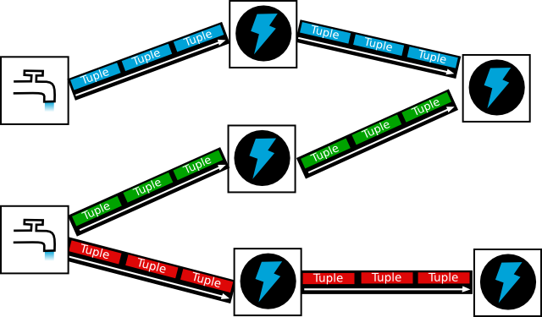
In stream processing, there is no end to a computation.
Stream processing

Slide 19
Elastic Stream Processing With Apache Storm
1
The value-chain of computation
3
2
Overview of computation models
8
Batch processing
8
Online processing
10
Stream processing
12
3
Frameworks for computation
14
Bulk data processing
14
Stream data processing
16
The lambda architecture
18
4
Apache Storm
21
5
Examples
29

Slide 20

Business needs results, but some faster than others.
Lambda Architecture

Slide 21
In a lambda architecture, stream is used to compensate for the time delay of batch for certain results.
The Lambda Architecture
Speed Layer
Time-framed data subset
Data
Query
Total data set
Batch Layer

Slide 22
Elastic Stream Processing With Apache Storm
1
The value-chain of computation
3
2
Overview of computation models
8
Batch processing
8
Online processing
10
Stream processing
12
3
Frameworks for computation
14
Bulk data processing
14
Stream data processing
16
The lambda architecture
18
4
Apache Storm
21
5
Examples
29

Slide 23

Big Data is best crunched one byte at a time.
Apache Storm

Slide 24
The main components on a logical level are Spouts, Bolts and tuples.
Apache Storm

Slide 25
Topology – The logic of processing
Components of Apache Storm
A topology in Storm defines
from where data is read, and
how it is processed.
It works by defining
Spouts,
Bolts, and
The streams they connect by.

Slide 26
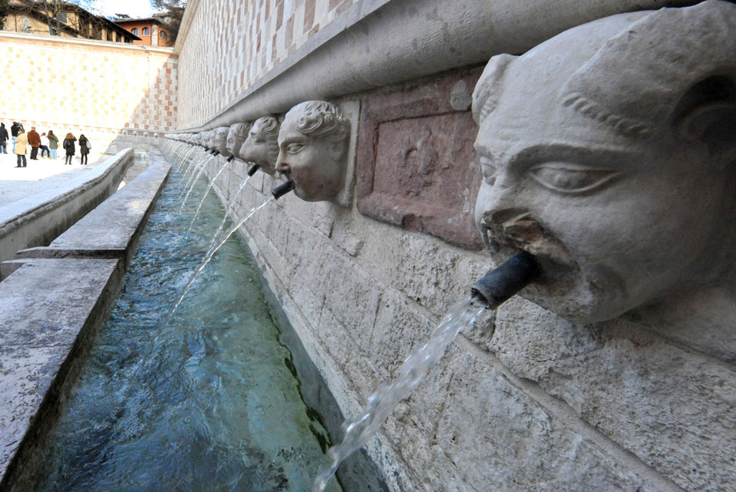
Spouts – Sources of tuples
Components of Apache Storm
A spout is a source of streams of tuples in a topology.
Spouts read tuples from an external source and emit them into the topology.
Spouts can either be reliable or unreliable:
A reliable spout is capable of replaying a tuple if it failed to be processed by Storm
An unreliable spout forgets about the tuple as soon as it is emitted.
And what about JMS?

Slide 27
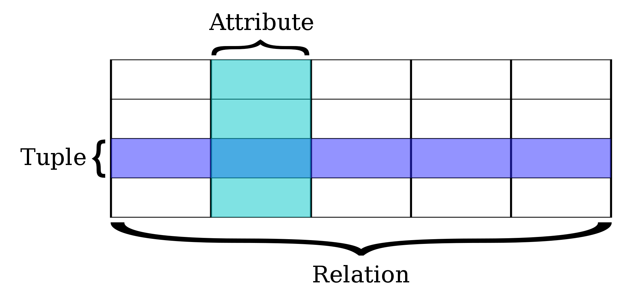
Tuples – self-contained units of data
Components of Apache Storm
A tuple is a finite ordered list of elements (Source: Wikipedia)
A tuple can be used to group any number of items into a single compound value. […] Tuples are useful for representing what other languages often call records — some related information that belongs together, like your student record. There is no description of what each of these fields means, but we can guess. A tuple lets us “chunk” together related information and use it as a single thing. (Source: http://openbookproject.net/thinkcs/python/english3e/tuples.html)
Source of image: Wikipedia

Slide 28
Bolts – Processors of data
Components of Apache Storm
Intentionally left blank ☺

Slide 29
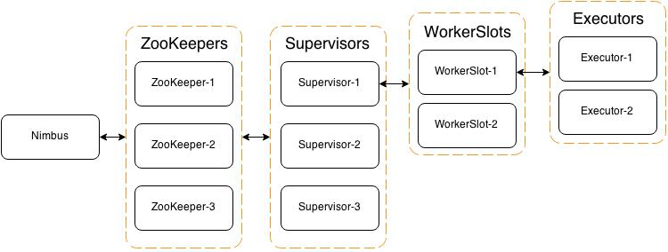
The technical components are Zookeeper, Nimbus and Supervisors, controlling Workers.
Components of Apache Storm
Cluster- Manager
Node- Manager
JVM- Instance
Threads
A topology is submitted to Nimbus. Nimbus submits spouts and bolts via Zookeeper to supervisors.
Nimbus sets up the stream configuration between spouts and bolts.
A supervisor installs a spout or bolt on an executor via one of its workers.
After the topology is successfully installed, Nimbus starts all spouts.
Spouts emit tuples to their respective streams.
Storm delivers the tuples to the configured bolts.

Slide 30
Elastic Stream Processing With Apache Storm
1
The value-chain of computation
3
2
Overview of computation models
8
Batch processing
8
Online processing
10
Stream processing
12
3
Frameworks for computation
14
Bulk data processing
14
Stream data processing
16
The lambda architecture
18
4
Apache Storm
21
5
Examples
29

Slide 31
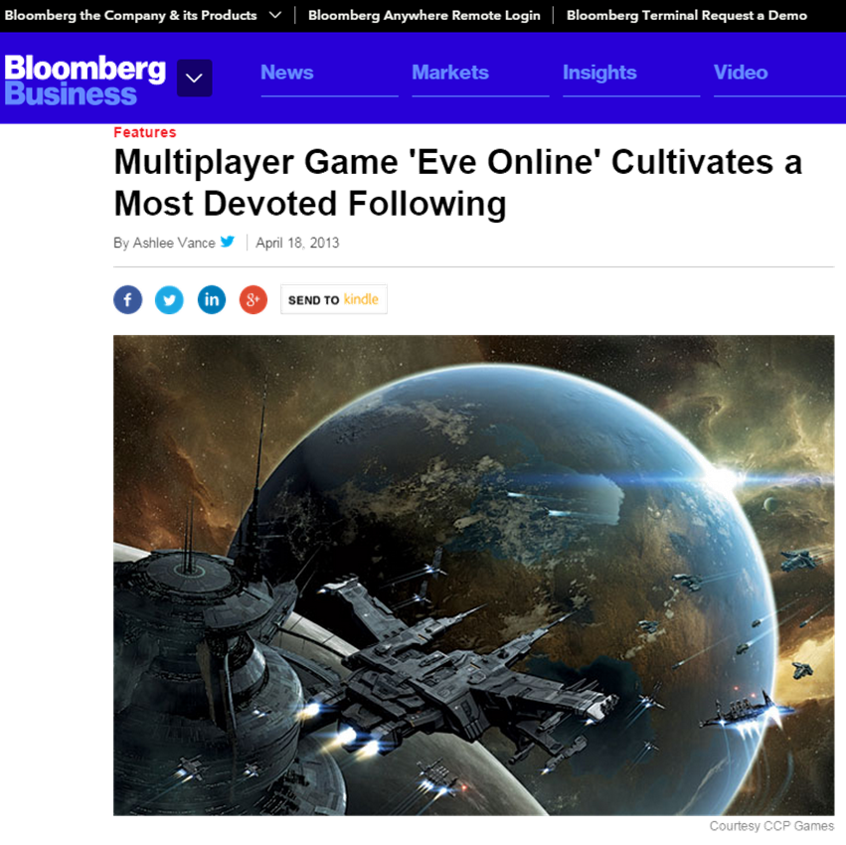
EVE Online – Pricing and Profitability
Gaming Example
Massively Multiplayer Online Role-Playing Game
One large virtual universe
7.800 connected star systems
Published in 2003
Approx. 500.000 subscribers
Avg. 30.000 players simultaneously online
Player-driven economy
Manufacturing
Trading

Slide 32
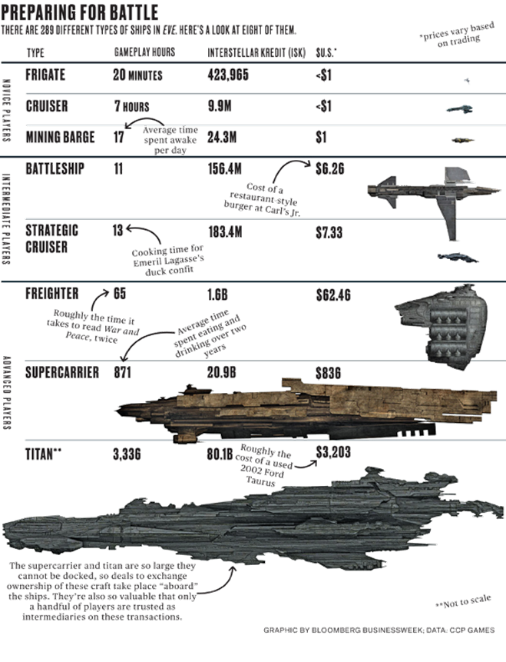
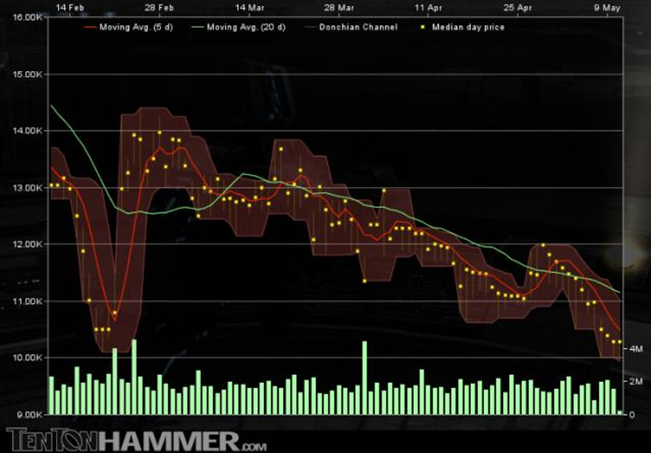
EVE Online Goods are traded, goods are manufactured and profits and losses are key to success
Gaming Example

Slide 33
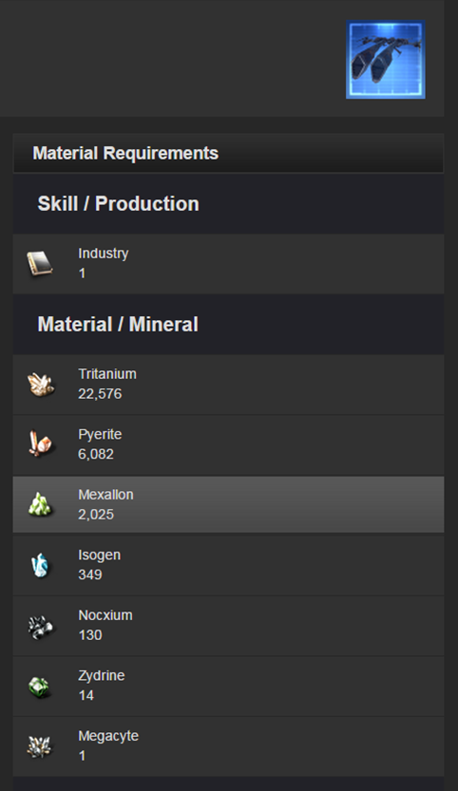
EVE Online This value chain can be modeled to be computed in real-time.
Gaming Example
A ship cost is
The sum of all material prices
A material price is
The amount of a material multiplied by the cost per unit
A unit price
Will change over time depending on the market
Profitability means
Ship price – ship cost >= 0
If one knows the cost and a realistic price, one knows whether its profitable to manufacture and sell it

Slide 34
Identify the operations necessary and apply them mathematically
Design for stream processing
Elastic processing needs functional decomposition
Identify the building blocks of the formula
Implement each building block in an elastic way (shared nothing approach, purely input-driven)
Efficient processing minimizes building blocks
Use many „small“ operations which get connected
Reduces the risk of errors
Optimizations in one place improve the overall performance
Result = function ( function(dataA), function(dataB) )

Slide 35
EVE Online How to model this with Apache Storm?
Gaming Example
Tritanium
Tritanium for Kestrel
Ship Cost for Kestrel
€
Zydrine
Router
Zydrine for Kestrel
Ship Cost for Rifter
€
Megacyte
Tritanium for Rifter

Slide 36
EVE Online Adding a profitability check to the model
Gaming Example
Tritanium
Tritanium for Kestrel
Ship Cost for Kestrel
€
Zydrine
Router
Zydrine for Kestrel
Ship Cost for Rifter
€
Megacyte
Tritanium for Rifter
Ship Price for Kestrel
Profitability Check Kestrel
€

Slide 37
EVE Online How to design this with Apache Storm?
Gaming Example
Tritanium
Tritanium for Kestrel
Ship Cost for Kestrel
€
Zydrine
Router
Zydrine for Kestrel
Ship Cost for Rifter
€
Megacyte
Tritanium for Rifter
(1) ? Software Architecture ?

Slide 38
EVE Online Classes per type of spout/bolt!
Gaming Example
Material spout
Router bolt
Volume cost calculator bolt
Ship cost calculator bolt
Tritanium
Tritanium for Kestrel
Ship Cost for Kestrel
€
Zydrine
Router
Zydrine for Kestrel
Ship Cost for Rifter
€
Megacyte
Tritanium for Rifter
(2) In Practice
Integration Bean
Java Bean

Slide 39
The logic best fits in a separate class and is integrated separately, to foster testability.
Spout Design

Slide 40
All ships need all materials, thus the logic can be generalized.
Bolt design

Slide 41
The total ship cost also is always constant and thus should only be implemented once.
Result calculation
(2) In Practice

Slide 42

Telco (Bandwidth regulation for mobile tariffs)
Telco Example

Slide 43
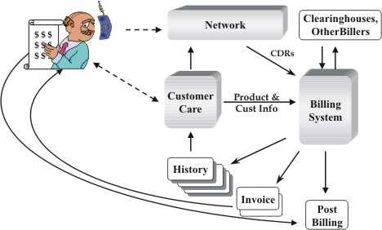
Telco (Bandwidth regulation for mobile tariffs)
Telco Example
Whenever one uses his mobile phone, the telecom network creates a stream of Call Data Records (CDR) to acknowledge the usage of the network.
These CDR events are used to bill the user.
The CDR data can also be used to reconfigure the network to enforce service levels.

Slide 44
Telco (Bandwidth regulation for mobile tariffs)
Telco Example
In-Memory Data
CDR source
Filter unimportant records
The network
Enforce SLA

Slide 45


Axel Irriger
Vice President
+49 (0) 170 / 45 07 002
axel.irriger@msg-systems.com
@axelirriger
www.github.com/axelirriger
msg systems ag (Headquarters)
Robert-Buerkle-Str. 1, 85737 Ismaning
Germany
www.msg-systems.com

